Slide 1


SS-1, UNIT 1
SOFT SKILLS
UNIT 1
TRANSFORMATION OF SENTENCES

Slide 2
RECAP
What is a sentence?
A sentence is a group of words which expresses a complete thought. It follows the basic grammatical rules of syntax. E.g.
Rupak is the tallest girl in the school.
A complete sentence has at least one subject and a main verb to state a complete thought.

Slide 3
What is a CLAUSE?
A group of words that forms part of a sentence and has a subject and a finite verb of its own is called a clause.
A clause that makes complete sense and it can stand independently on its own is called the Principal or Main Clause .
A clause that cannot stand on its own and depends upon another clause to make complete sense is called a subordinate clause or dependent clause.

Slide 4
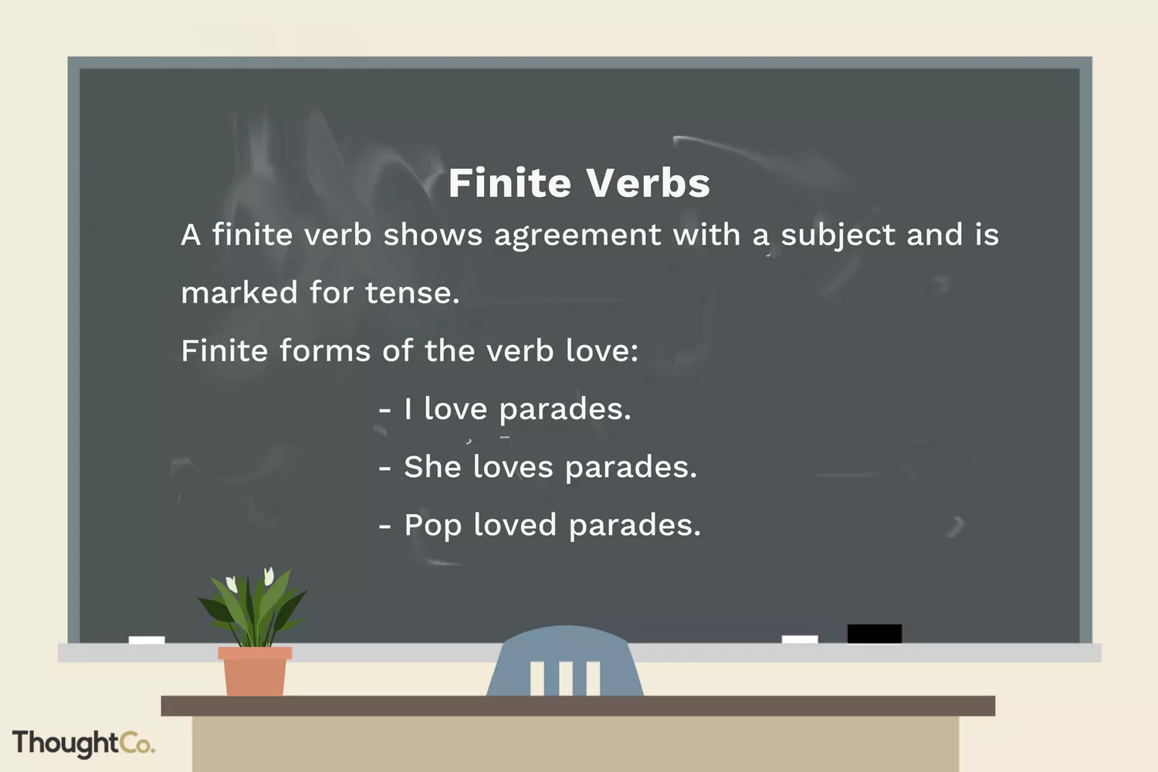

Slide 5
Difference between dependent and independent clauses
An independent clause (or principal clause) is a clause that expresses a complete thought.
It can stand alone if it is not the part of a sentence.
Eg- He went to the theme park, and he went on all the rides.
A dependent clause (or subordinate clause) is one that cannot stand alone and depends on the principal clause for its meaning.
(i.e., it does not express a complete thought).
If you can work on Sundays, I will pay you double.
I will wait for my friend until the sun sets.

Slide 6
TYPES OF SENTENCES (According to the intentions of the speaker or writer and the manner of expression)
A Declarative or Assertive Sentence simply makes a statement or expresses an opinion. In other words, it makes a declaration. This kind of sentence ends with a period/full stop.
E.g. My friend is a good singer
We travelled to Jaipur by bus.
An interrogative sentence asks a question. This type of sentence often begins with who, what, where, when, why, how, or do, and it ends with a question mark.
e.g. Who gave you that information?
Where did the detective go?

Slide 7
An imperative sentence gives a command, makes a request ,gives suggestions or advice. It usually ends with a period/full stop.
e.g. Don’t talk so loudly
You should take your medicines regularly
Please shut the door.
An exclamatory sentence is a sentence that expresses great emotion such as excitement, surprise, happiness and anger, and ends with a mark of exclamation.
e.g. What a beautiful day this has been!
How well she sings!
An Optative Sentence is a sentence that expresses a wish or a prayer. It often ends with an exclamation mark.
e.g. May you be blessed with success!
May God grant you your wishes.

Slide 8
Kinds of Sentences: (according to the grammatical structure)

Slide 9
Simple Sentences
• A simple sentence is a basic sentence that expresses a complete thought. It contains:
1. A subject
2. A verb
3. A complete thought
Ex. The train was late. Mary and Maggie took the bus.

Slide 10
SAMPLE SIMPLE SENTENCES
Going to the field, he saw a snake.( using participles)
He is too cleaver to be deceived. ( using infinitives)
Mahadev, a goldsmith, was teased by the people of the village. ( using noun or phrases in apposition)
The day having dawned, the people went to the canal.
On going home, we found our servant absent.
Baldev reached the playground punctually.

Slide 11
Compound Sentences
• A compound sentence contains two main clauses or independent clauses joined by a comma and a coordinating conjunction or a semi-colon.
Conjunctions (for, and, nor, but, or, and yet, so) join these independent clauses. (Hint: The conjunctions spell FANBOYS.)
• Compound sentences connect two simple sentences, but they often do not show a clear relationship between the two parts.
Ex. I waited for the bus, but it was late.

Slide 12
SAMPLE COMPOUND SENTENCES
Mary doesn’t like cartoons because they are loud, so she doesn’t watch them.
The girls were painting animal pictures, and Katrina spilled the paint.
Your children are older, so they probably wouldn’t be scared.
They wanted to go to Paris, but I wanted to see London.
I spent all my savings, so I can’t go to France this winter.
I want to lose weight, yet I eat chocolate daily.

Slide 13
COMPLEX SENTENCES
A complex sentence is an independent clause joined by one or more dependent clauses.
A subordinating conjunction begins the dependent clause
A dependent clause that begins a sentence must be followed by a comma

Slide 14
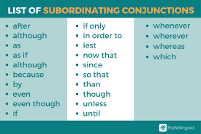

Slide 15
Complex Sentences
• If the dependent clause comes before the independent clause, add a comma after the dependent clause. If the main clause comes first, no comma is needed between the two.
• Complex sentences can show a more specific relationship between the parts of the sentence than a compound sentence.

Slide 16
Complex Sentence Examples
• Independent clause first: We won the game because we worked together as a team.
• Dependent clause first: Although I broke my arm, I still cheered for my team from the sidelines.

Slide 17
Sample Complex Sentences
Because he was late again, he would be docked a day's pay.
While I am a passionate basketball fan, I prefer football.
Although she was considered smart, she failed all her exams.
Whenever it rains, I like to wear my blue coat.

Slide 18
COMPOUND COMPLEX SENTENCES
A compound complex sentence is a sentence that has at least two independent clauses and at least one dependent clause.
The same subordinating conjunctions are used to introduce the dependent clauses.
The same co-ordinating conjunctions are used for joining the independent clauses.

Slide 19
Compound-Complex Sentences
• A compound-complex sentence contains two independent clauses and at least one dependent clause.
• This is the most sophisticated type of sentence you can use.
Ex. Though Jack prefers watching comedy films, he rented the latest spy thriller, and he enjoyed it very much.

Slide 20
Identify the type of sentence
1.Our coach will host a pizza party when we win our first game.
2. Olivia and Caroline went to the movies.
3. James grilled burgers, and Patrick made a salad.
4. Since I made the honor roll, my parents let me have a friend spend the night.
5. Before Alice called me, she called her mom, and her mom asked her to babysit her brother.

Slide 21
ANSWER KEY
COMPLEX
COMPOUND
COMPOUND
COMPLEX
COMPOUND COMPLEX

Slide 22
Test Yourself – Simple, Compound, Complex, or Compound-Complex?
1. The teacher walked into the classroom, greeted the students, and took attendance.
2. Juan played football while Jane went shopping.
3. Juan played football, yet Jim went shopping.
4. Although Mexico has a better team, they lost the tournament, and their more aggressive style did not pay off.
5. The island was filled with many trails winding through the thick underbrush, a small lake, and dangerous wild animals.
.

Slide 23

Transformation of Simple Sentences into Compound Sentences

Slide 24

Read through the following simple sentences and transform them into compound sentences by using appropriate coordinating conjunctions.
1. Following the trail, we reached the destination.
2. Being sick, I went to the doctor.
3. In spite of the rain, the children went out to play.
4. Having handed over the flowers to my mom, I hugged her.
5. In the event of you not reaching in time, we will postpone the operation.

Slide 25
Answer key
1. We followed the trail and reached the destination.
2. I was sick, so I went to the doctor.
3. It was raining but the children went out to play.
4. I handed over the flowers to my mom and hugged her.
5. You should reach in time or we will postpone the operation.

Slide 26
Transformation of Simple Sentences into Complex
Sentences

Slide 27

Go through the following simple sentences and transform them into complex sentences by using suitable subordinating conjunctions.
1. Because of the rain, we decided to stay back home.
2. To finish your project in time, you should start now.
3. Besides being a good doctor, Sheena is a great artist.
4. Despite the several obstacles, Aaron made it to the end.
5. On seeing the bride, all her friends were moved to tears.
.

Slide 28

Answer key
1. As it was raining, we decided to stay back home.
2. If you want to finish your project in time, you should start now.
3. Not only is Sheena a good doctor but also a great artist.
4. Though there were several obstacles, Aaron made it to the end.
5. As soon as all her friends saw the bride, they were moved to tears.

Slide 29

Transformation of Compound Sentences to Complex Sentences

Slide 30

Check out the following compound sentences and convert them into complex sentences by replacing the coordinating conjunction with the most appropriate subordinating conjunction.
1. I finished my homework and went out to play with my friends.
2. It was very cold, so I wore a sweater.
3. Harold is not keeping well, yet he helped his sister out with the household chores.
4. You must practise well, or you will not be able to perform well.
5. It was cloudy, therefore we went by car.

Slide 31
Answer key
1. After I finished my homework, I went out to play with my friends.
2. It was so cold that I had to wear a sweater.
3. Although Harold was not keeping well, he helped his sister out with the household chores.
4. If you do not practice well, you will not be able to perform well.
5. Since it was cloudy, we went by car.

Slide 32

Go through the following sentences and transform them as directed.
1. If you don’t leave now, you will get caught in the rain. (Change into a simple sentence)
2. Though we were not sure if we could finish it, we volunteered to help them. (Change into a compound sentence)
3. Not only did Leslie work on his assignment but also helped me finish mine. (Change into a compound sentence)
4. As a result of our continuous efforts, we were able to successfully create a working model of the hospital bed. (Change into a complex sentence)
5. Morgan was a nurse and so her job was to take care of her patients. (Change into a simple sentence)

Slide 33
Answer key
1. In the event of you not leaving now, you will get caught in the rain.
2. We were not sure if we could finish it, but we volunteered to help them.
3. Leslie worked on his assignment and helped me finish mine as well.
4. Since we put in continuous efforts, we were able to successfully create a working model of the hospital bed.
5. Being a nurse, Morgan’s job was to take care of her patients.

Slide 34
There are some other types of transformations too. The notes attached would help you have a better hand at the topic.

